Slide 1

Further neural network architectures NLP in one day

Slide 2
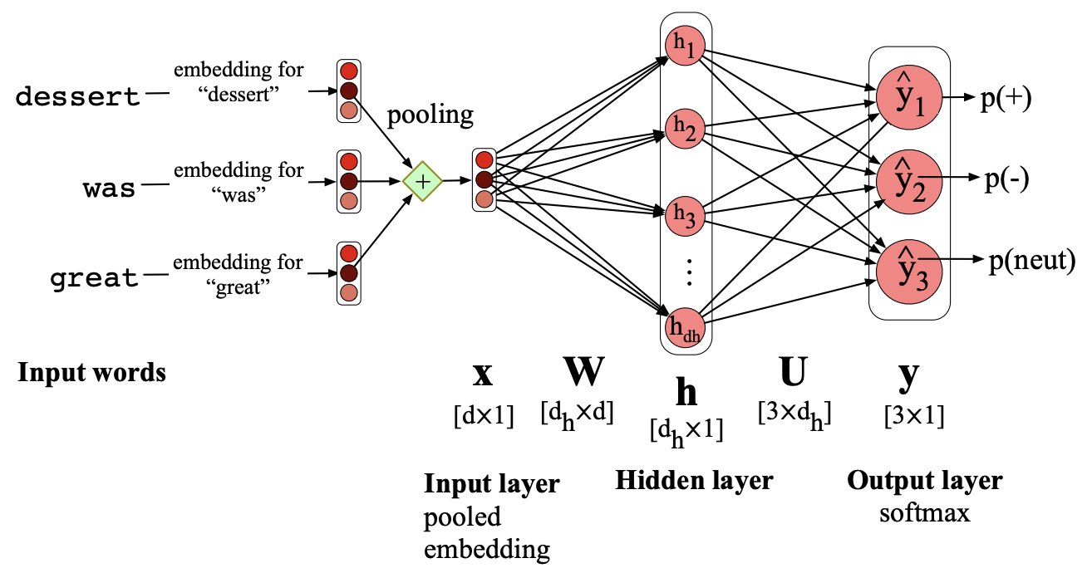
Other architectures
We can design network topologies different neural processing units to increase the efficiency and representational power of our layers:
Connect regions of input or hidden layers to single nodes in the next layer (locally connected)
Learn features from one region that can be applied to others (convoluting)
Carry over information from one step to the next (memory)
Updating our weights becomes more complicated!
What about sequential information? Surely this is important in language?
Up to now, our networks have consisted of dense layers where all neurons in one layer are connected to all neurons in the following layer
(Jurafsky and Martin, Fig. 7.11)

Slide 3
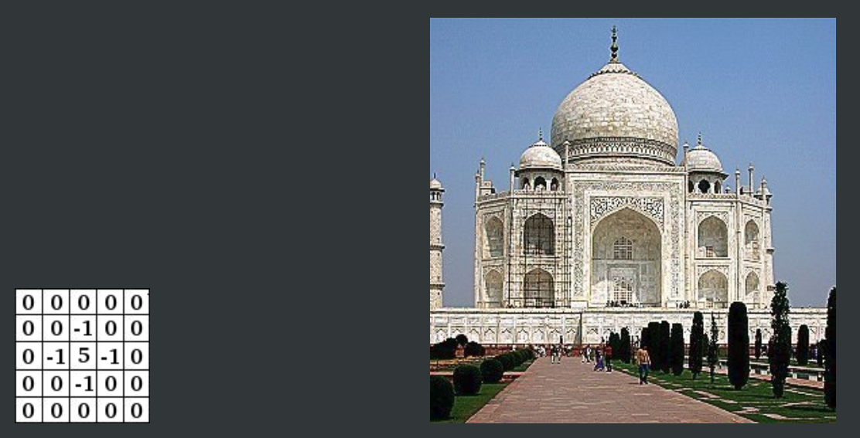
Convolution - sharpening
From the GIMP manual, V2.8, https://docs.gimp.org/en/index.html

Slide 4
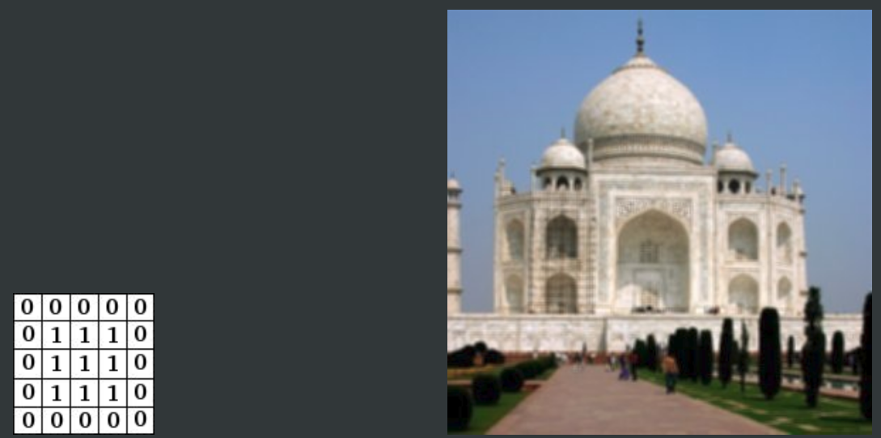
Convolution - blurring
From the GIMP manual, V2.8, https://docs.gimp.org/en/index.html

Slide 5
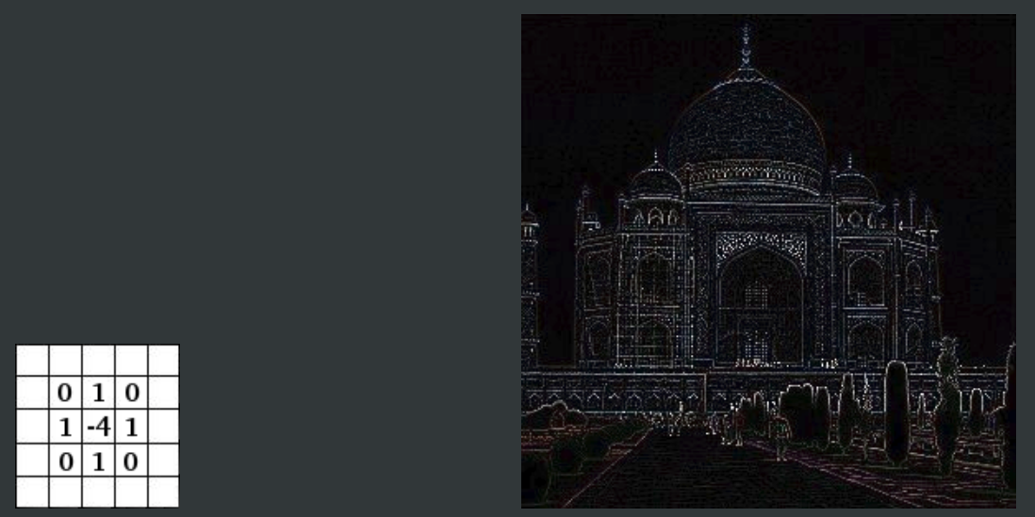
Convolution - edge detection
From the GIMP manual, V2.8, https://docs.gimp.org/en/index.html

Slide 6
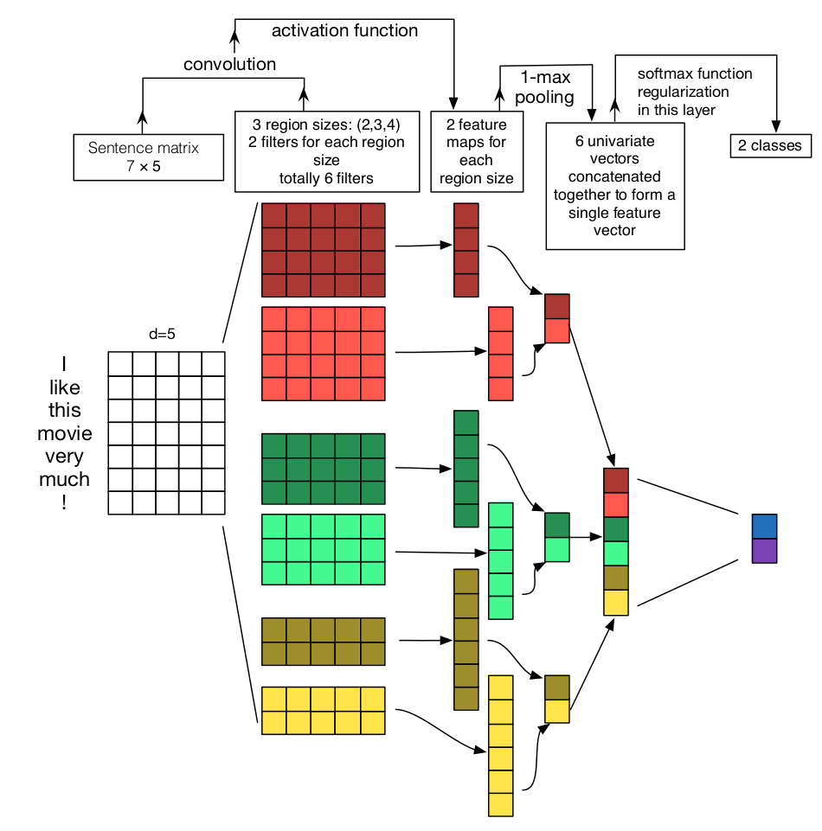
Applying convolution to text with CNNs
Credit: A Sensitivity Analysis of (and Practitioners' Guide to)
Convolutional Neural Networks for Sentence Classification
Ye Zhang, Byron Wallace. https://arxiv.org/abs/1510.03820

Slide 7
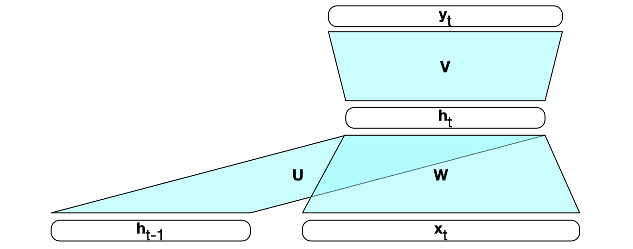
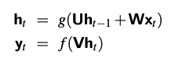
Recurrent neural network (RNN)
To take account of sequential information, we could feed in the output from the previous step to each new step
(Jurafsky and Martin, Fig. 9.3)

Slide 8
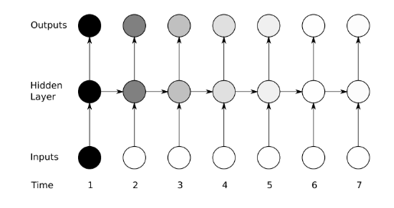
RNN: the signals degrade over time
Image: Alex Graves, Supervised sequence labelling. Springer. 2012.

Slide 9
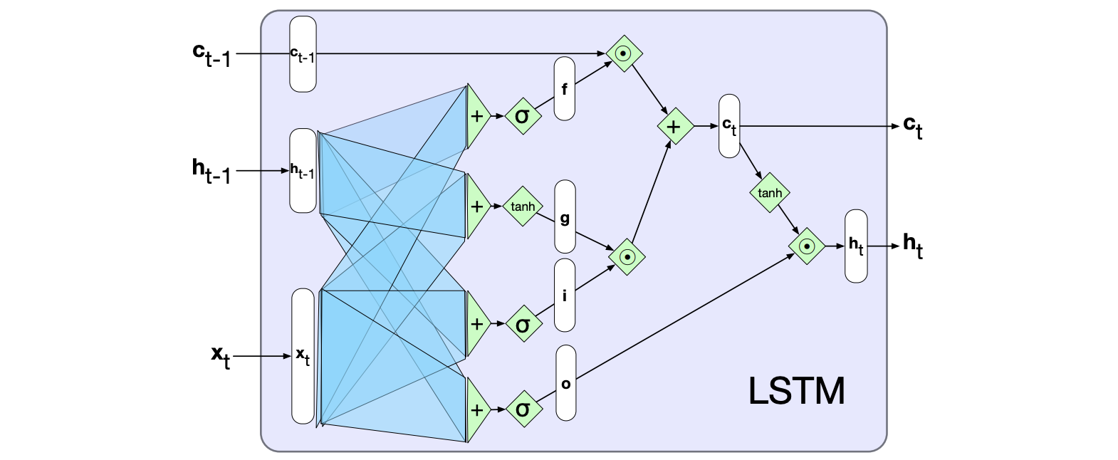
Long Short Term Memory (LSTM)
We can overcome the decay of RNNs by learning what we should forget and
what we should remember at each step
Context c and hidden state h vectors are passed through from previous step
Forget gate f deletes information from the context no longer needed
Add gate g selects information to add to the current context
Output gate o selects what information is required for the current hidden state (not future ones, which were dealt with above)
(Jurafsky and Martin, Fig. 9.13)

Slide 10
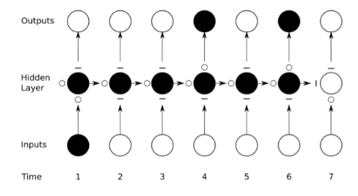
LSTM selectively forgets and remembers information at each step
Image: Alex Graves, Supervised sequence labelling. Springer. 2012.

Slide 11
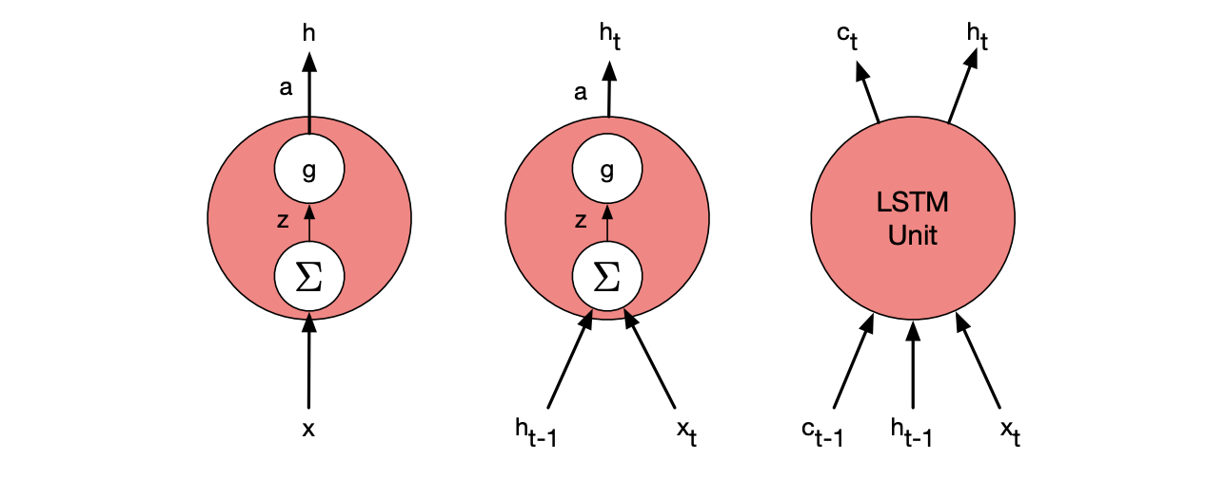
We can see these as different processing units
Simple feedforward unit
Recurrent unit
LSTM unit – as with the others, it is self-contained - modular
(Jurafsky and Martin, Fig. 9.14)

Slide 12
Thank you
angus.roberts@kcl.ac.uk https://www.kcl.ac.uk/people/angus-roberts

